Slide 1
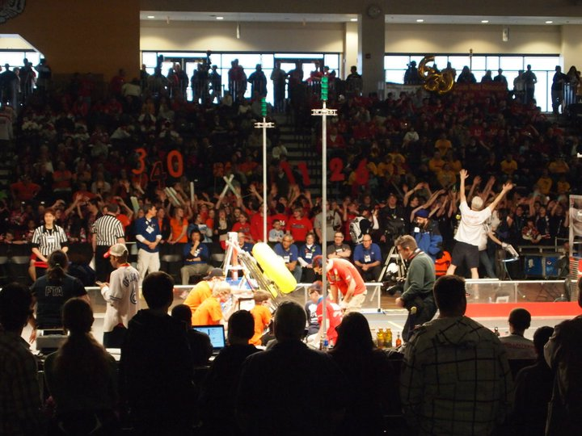

http://www.youtube.com/watch?v=biOfnBxuW84&feature=related&safety_mode=true&persist_safety_mode=1

Slide 2
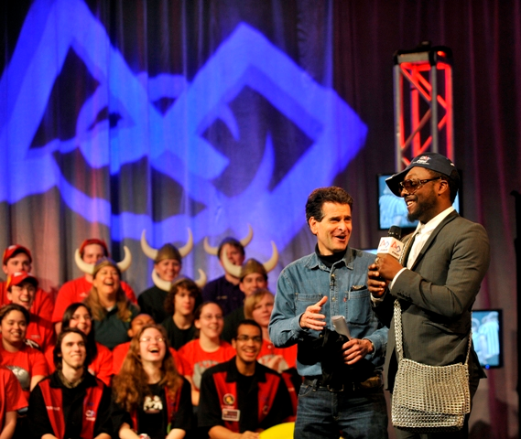
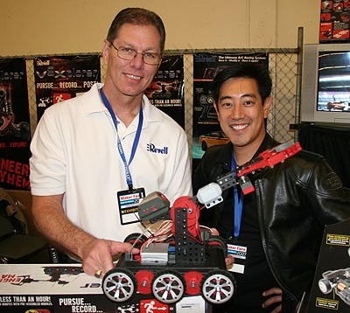
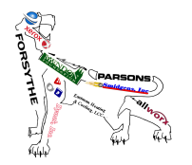
What is FIRST?
Mission
Gracious Professionalism
Myths
Grant Imahara of Mythbusters
Dean Kamen, Founder of FIRST with will.i.am of the Black Eyed Peas

Slide 3
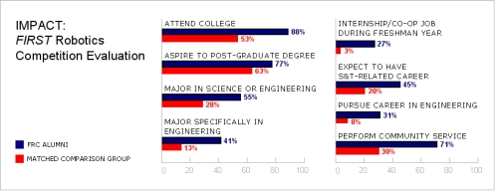
FIRST Students Are…

Slide 4
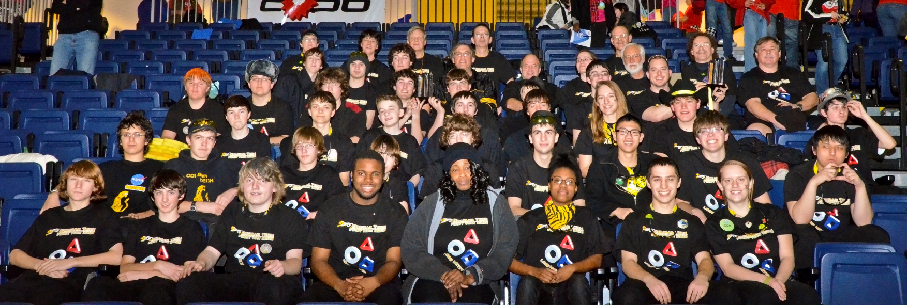
Cougar Tech
  History
  Build Season
  Off Season

Slide 5
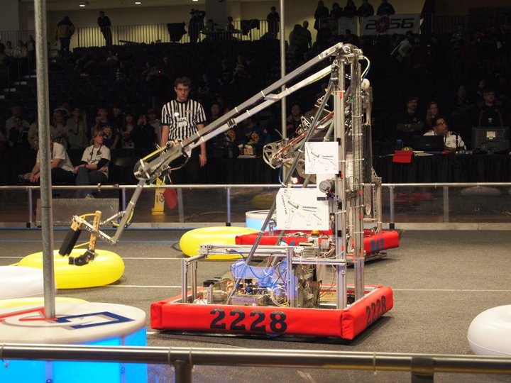
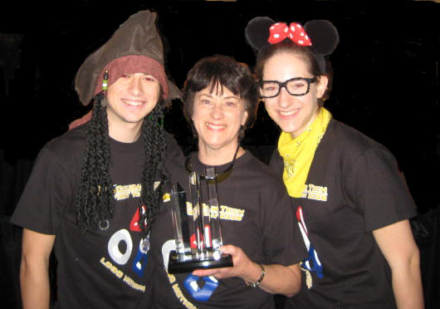
Competition
The Game Game Animation
Awards
  Coopertition
  Business Plan
  Second Place Safety

Slide 6
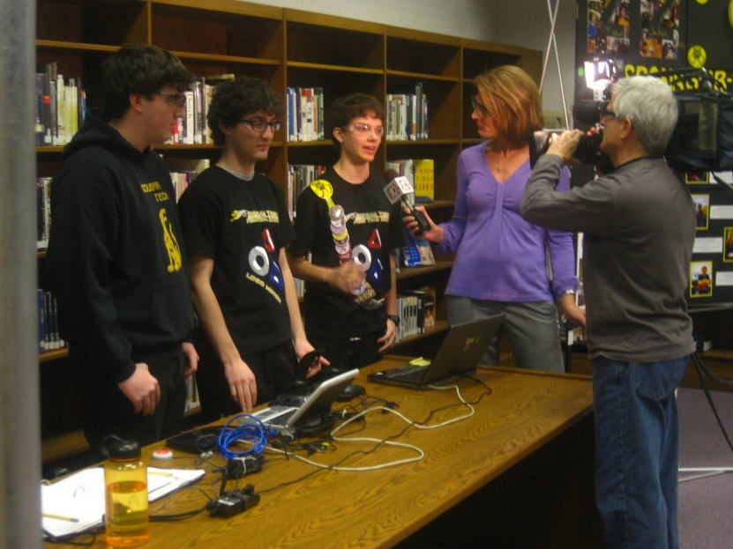
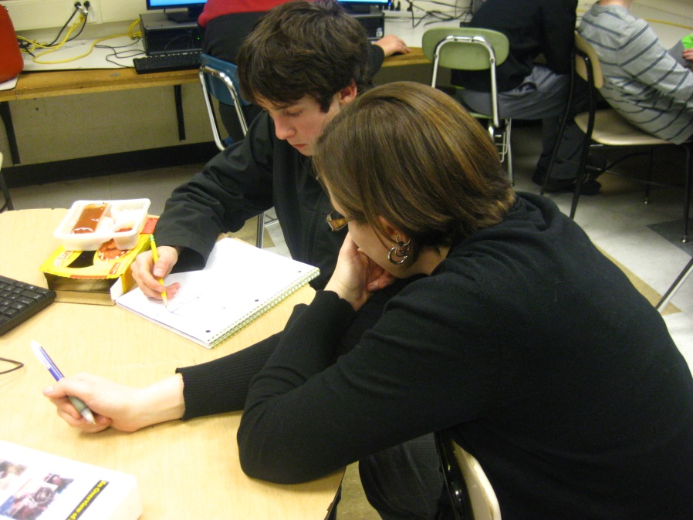
What’s In It For You?
Student Internships
Company Exposure
Sponsorship Benefits

Slide 7
Funding Needs for 2011-2012 Season
Category | Item | Amount
Finger Lakes Regional Competition | Includes: Registration, Transportation, Meals, Marketing, Awards | $ 8,300
Second Regional Competition | Includes: Registration, Travel, Marketing, Awards | $14,800
Competition Robot | Includes: Tools, Robot Parts, Field Elements, Safety Glasses, Shipping | $ 5,400
Practice Robot | Includes: Drive Base and Miscellaneous costs | $ 2,100
Ruckus | Includes: Registration, Transportation | $ 300
Community Outreach | Includes: Sponsor two FLL teams, Booth Fees, Awards, End of Year Banquet, Food during build season, Prizes for games | $ 2,200
National Competition | Includes: Registration, Shipping, Travel, Marketing, Awards | $21,300
Total |  | $54,400

Slide 8
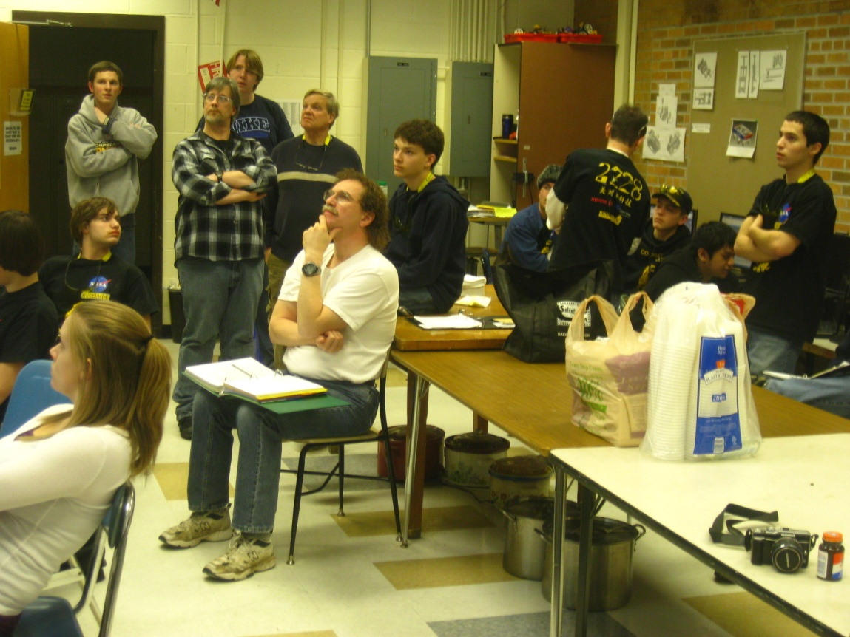
Become a Sponsor
Your Involvement
Your Expertise
Your Brain Power

Slide 9

Q & A
Robin Willick
robin.willick@gmail.com

