Slide 1

What is a Mentor?
CougarTech Team 2228
Learning Academy
Mentor Workshop
Saturday, August 20, 2011

Slide 2
What
A
Mentor
I
s
Your
Thoughts

Slide 3

One Perspective
Mentoring – developing insight to turn
hindsight into foresight!

Slide 4
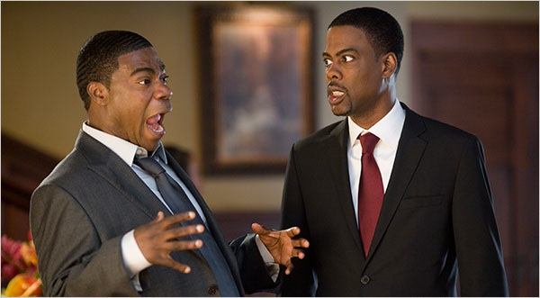
What a Mentor Isn’t
Terrifying Truths

Slide 5
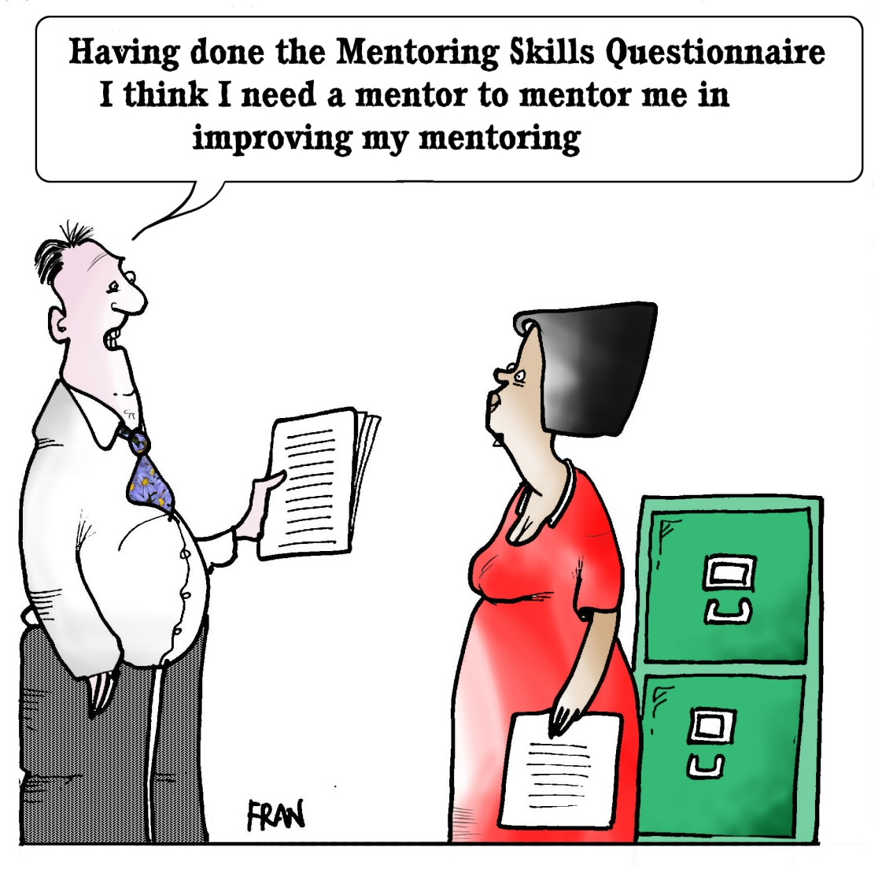
Muddled Befuddlement

Slide 6
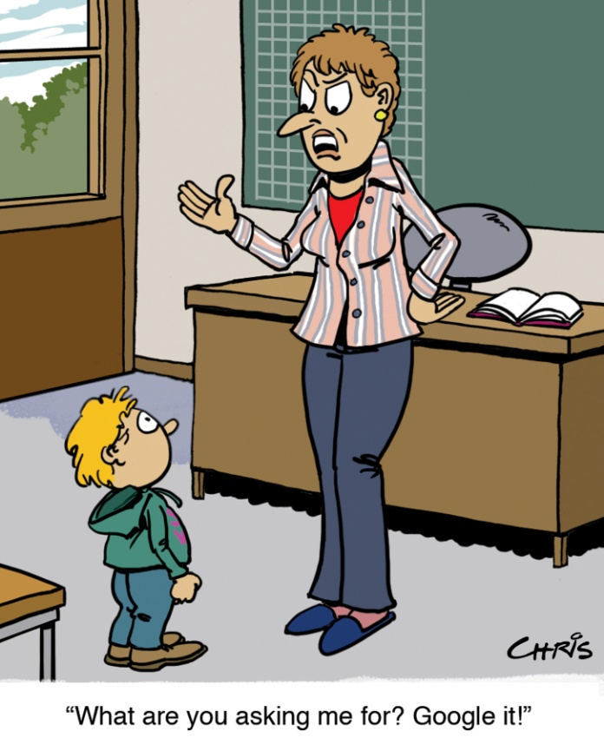
Absence Abounding

Slide 7
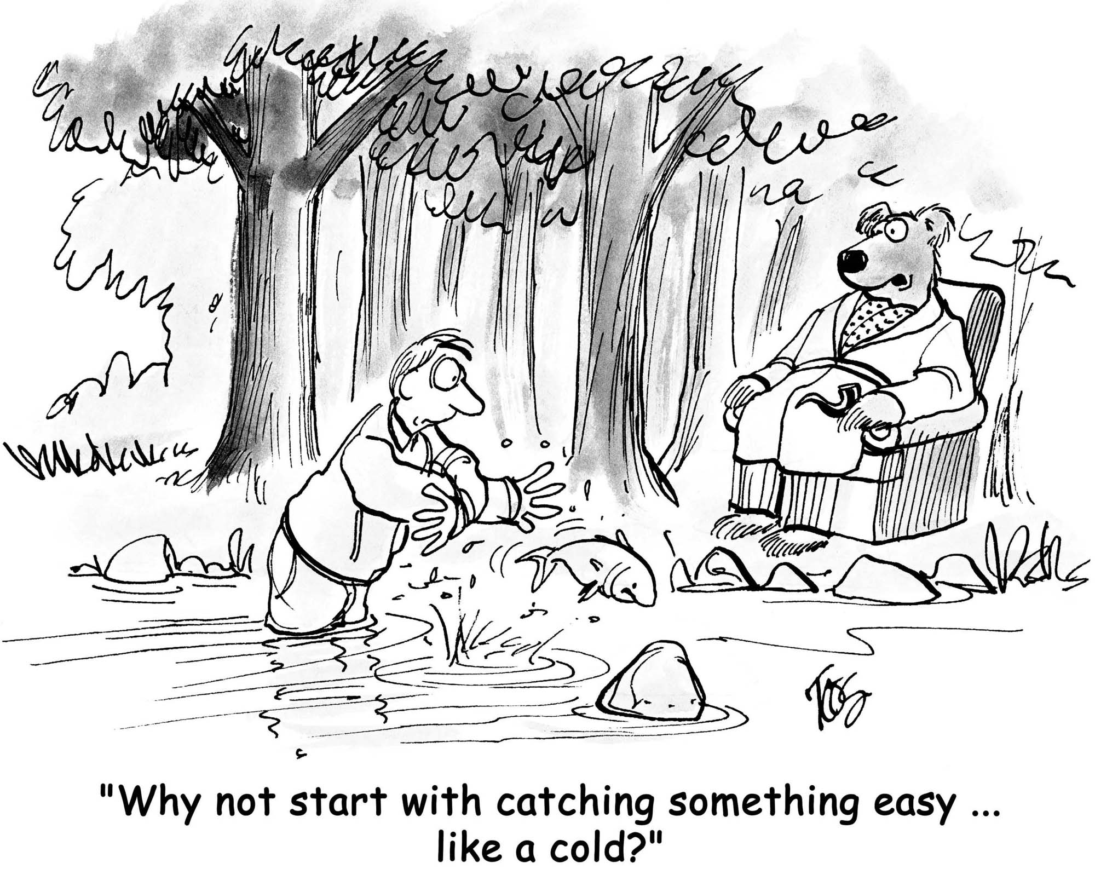
Startlingly Sarcastic

Slide 8
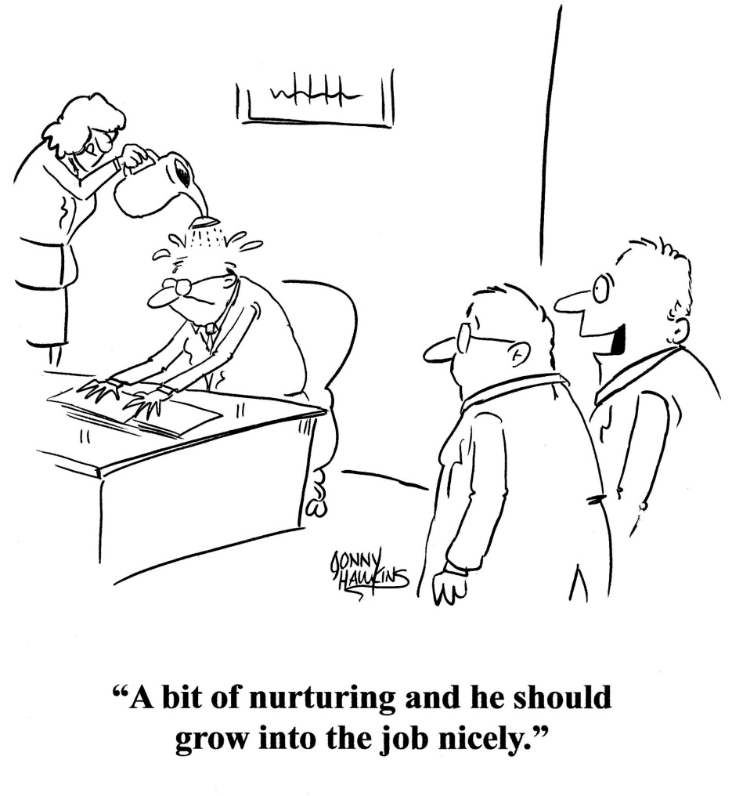
Oppressively Overbearing

Slide 9

F.I.R.S.T. Mentor Reminders
We are a winning team because we foster a learning environment
We are Facilitators rather than Creators
“Remember what’s important – the robot is of secondary concern, the students are primary.” Nemo
“Mentoring is a brain to pick, an ear to listen, and a push in the right direction.” – John Crosby

Slide 10

l
Open Discussion

